Slide 2
Computer vision Project
department of telecommunications and information processing
research group Image processing and interpretation

Slide 3
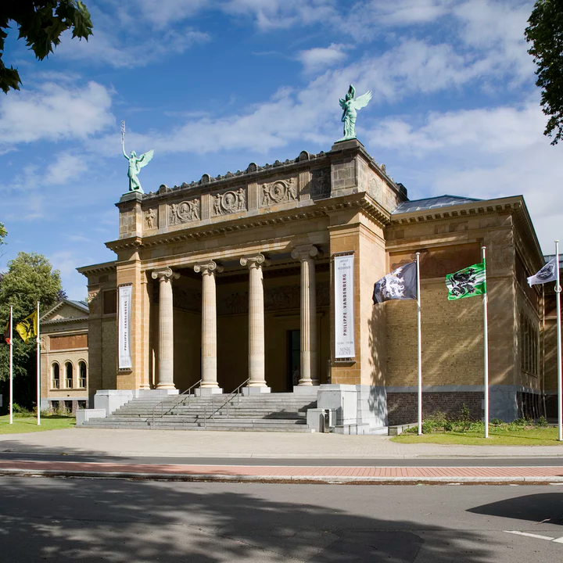

Slide 4
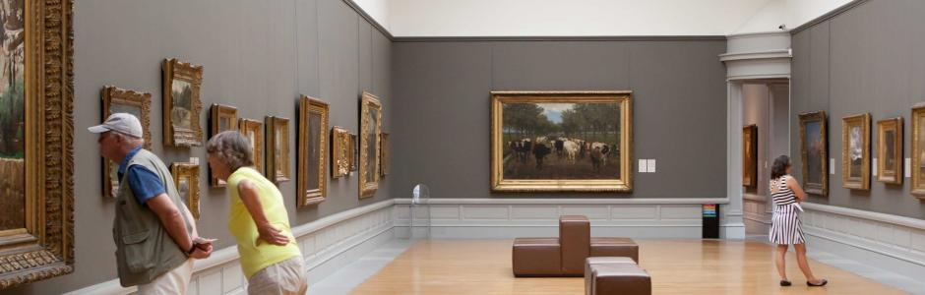

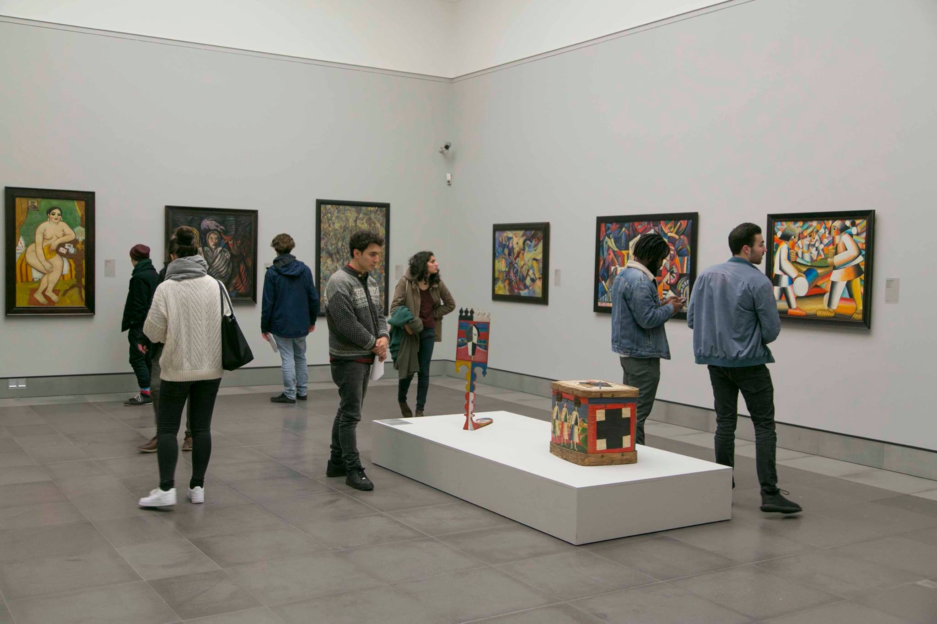
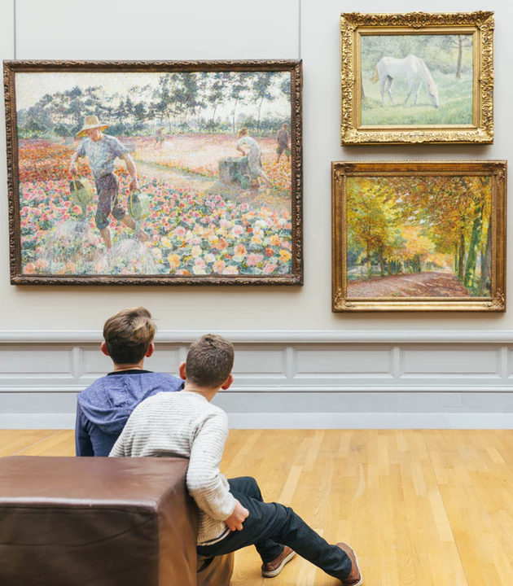

Slide 5
The project

Slide 6
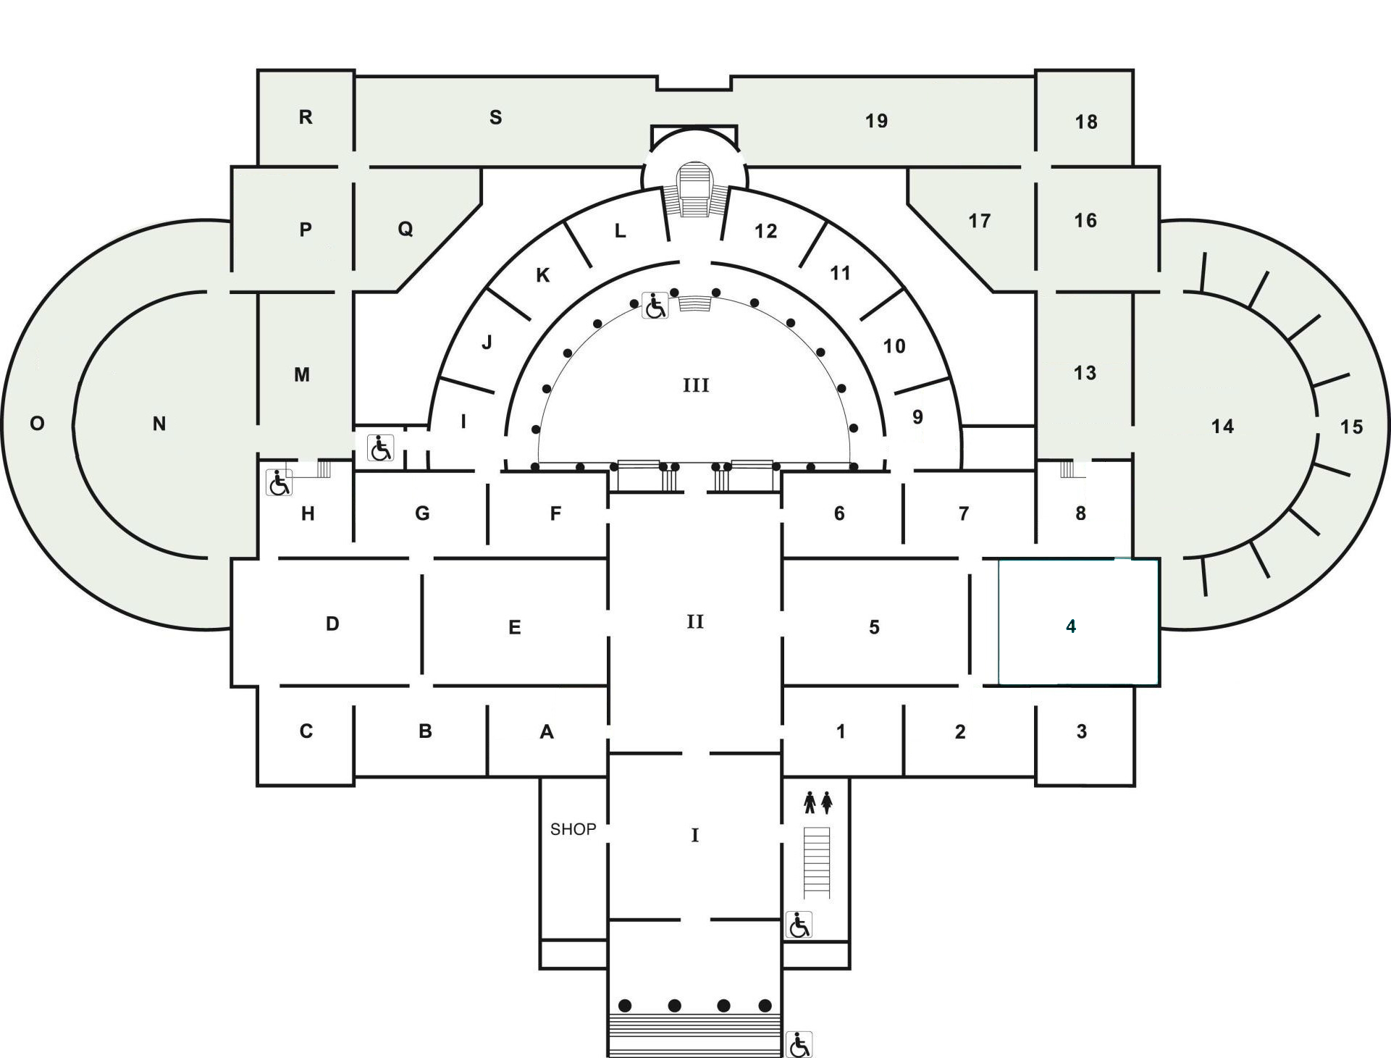
Indoor localization in the Msk
Floor plan MSK

Slide 7
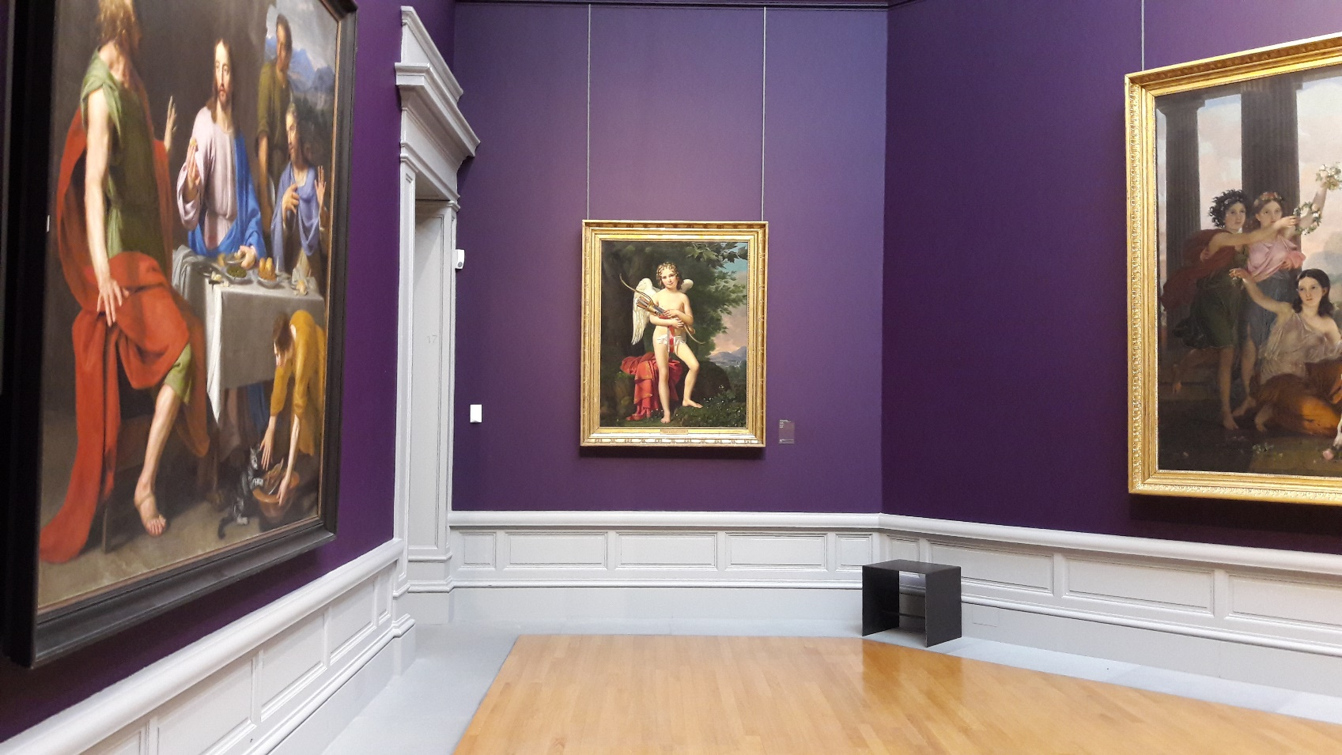
Recognition based indoor localization
Artworks are easily recognizable landmarks

Slide 8
Recognition based indoor localization
Detect paintings from video frames

Slide 9
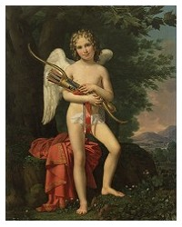
Recognition based indoor localization
Eros -
Joseph Paelinck
Match painting with database

Slide 10
Recognition based indoor localization
Localize the painting
Eros -
Joseph Paelinck

Slide 11
Assignment

Slide 12
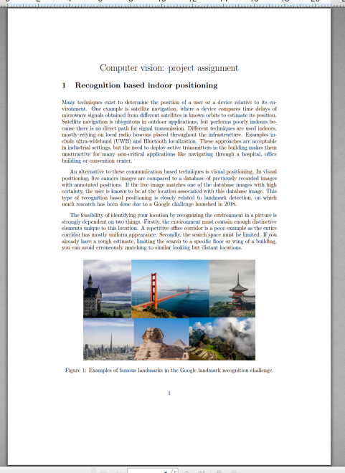
Project assignment
Read the project assignment carefully!
PDF Project_2021 on Ufora > Inhoud

Slide 13
practicalities
Download the data from: telin.ugent.be/~dvhamme/computervisie_2021/
Groups of max. 5 students
Make a github repository at github.ugent.be
add sroegier and dvhamme as contributors
all code and documents on this repo
no datasets, databases or videos on the repo

Slide 14
Deliverables and deadlines
Sparsely documented source code (date of exam)
Paper (May 21th, 2021)
Final presentation (date of exam)

Slide 15
Supervision
Forum on Ufora
Per group (start thread titled: Groep X – assignment X)
General
MS Teams during the regular contact hours Tuesday 13:30-15:30
At least one student per group should be present every week
Full group present at May 11th, schedule will be communicated

Slide 16
Dataset
At telin.ugent.be/~dvhamme/computervisie_2021/ you will find
Database.zip set of pictures organized per hall
Database_paintings.zip manually extracted paintings from this picture set
Database_log.csv bounding box coordinates of the extracted paintings
Msk_floorplan.png building floor plan
Videos collection of test videos captured while walking through MSK

Slide 17
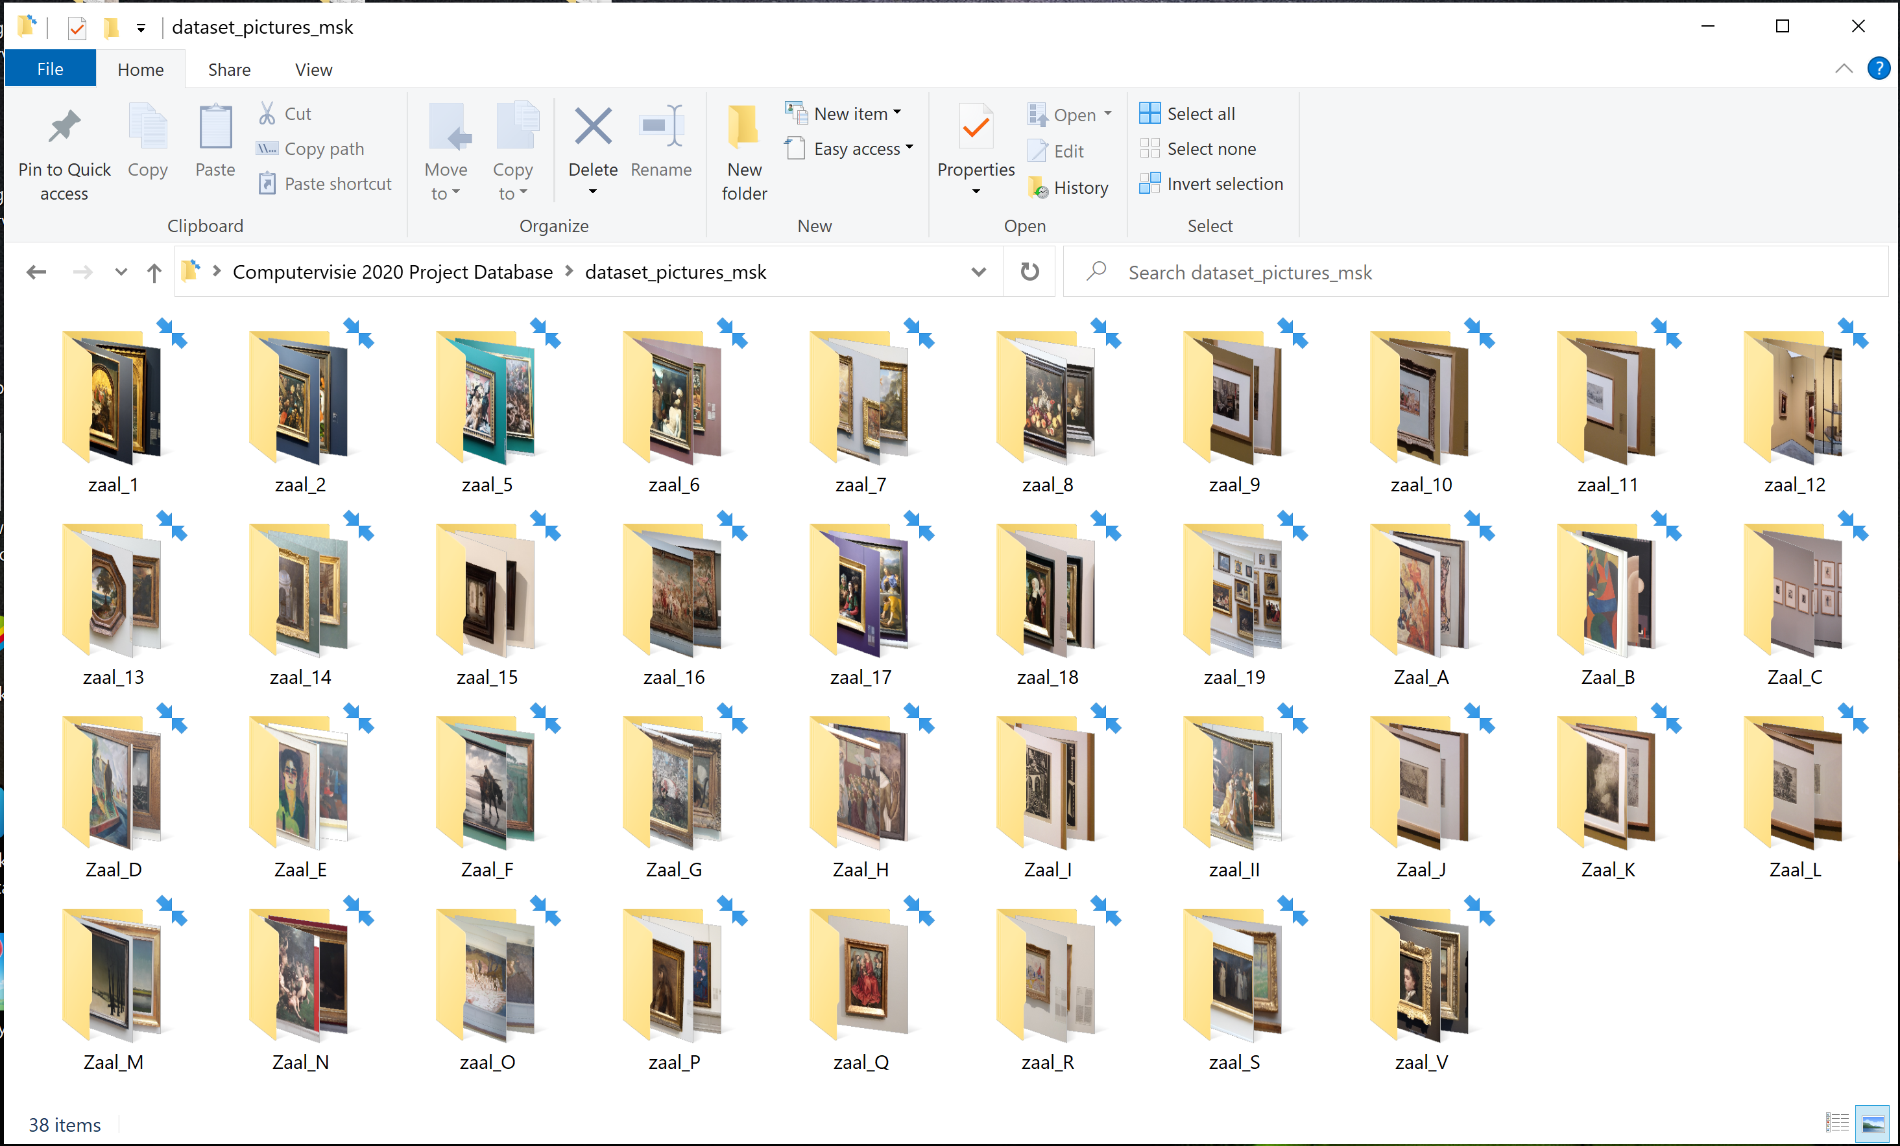
Dataset
dataset_pictures_msk: photographs of all paintings in the MSK, grouped per exhibition hall

Slide 18
Assignments
Painting detection
Matching
Localization
Demo

Slide 19
Assignment 1

Slide 20
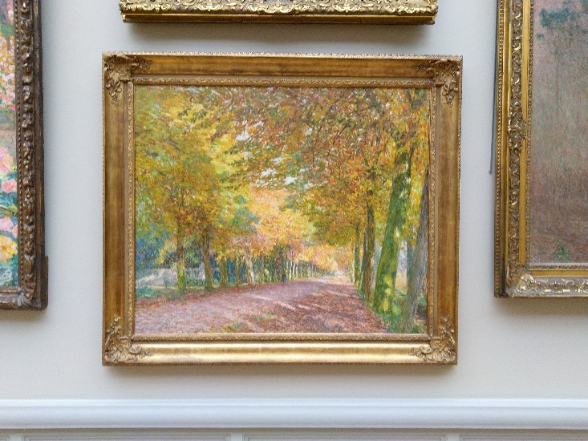
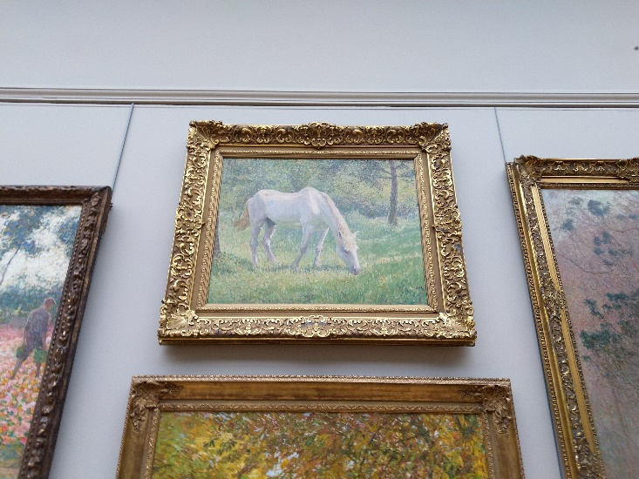
Painting detection
Write an unsupervised painting detection program. Example:

Slide 21
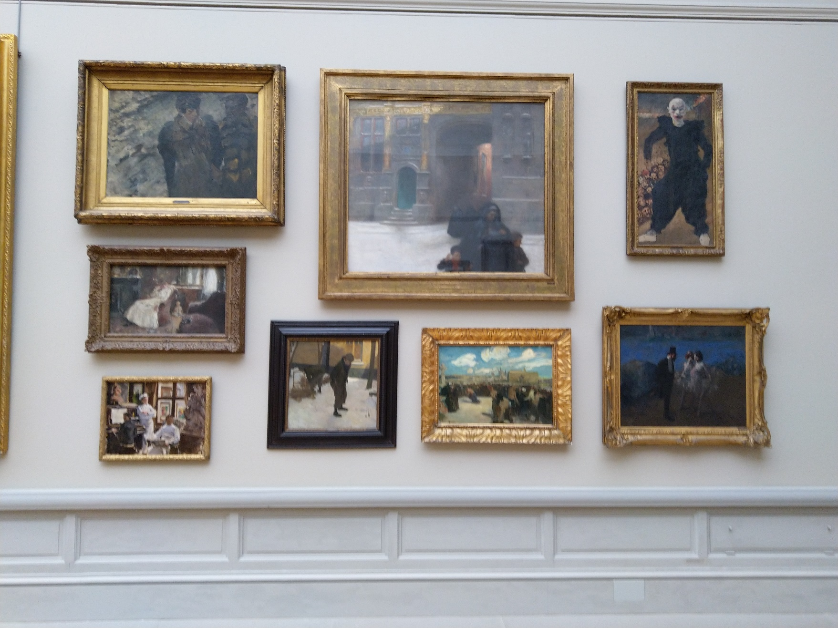
Painting detection
Quantitative evaluation with database entries:
False negatives
False positives
Bounding box accuracy (e.g. Intersection-Over-Union)
Database entry / Ground truth
Painting Detector
False negative
False positive

Slide 22
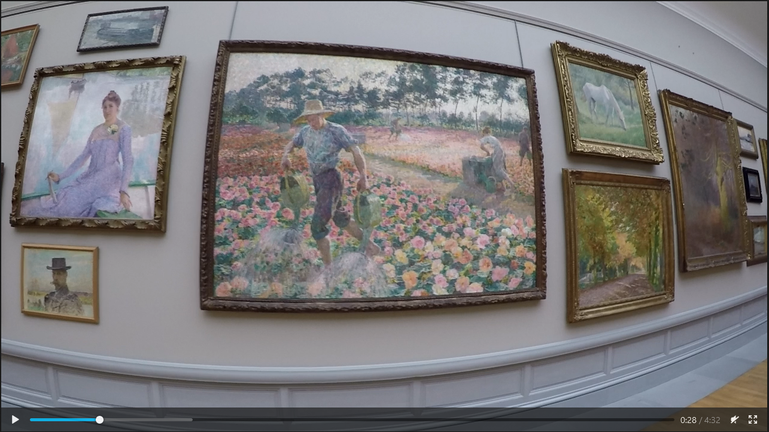
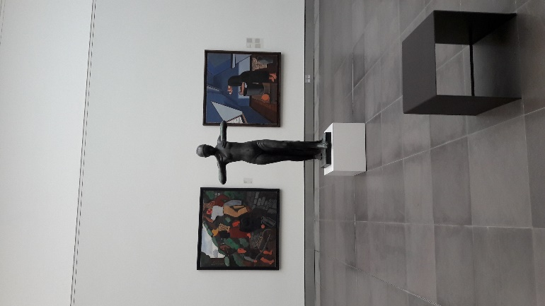
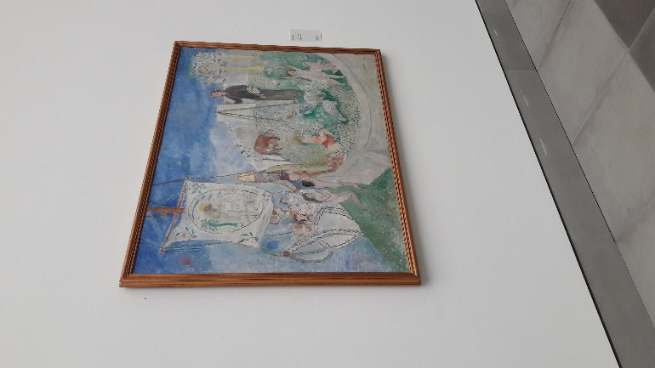
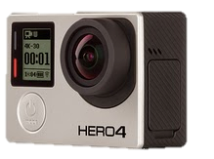
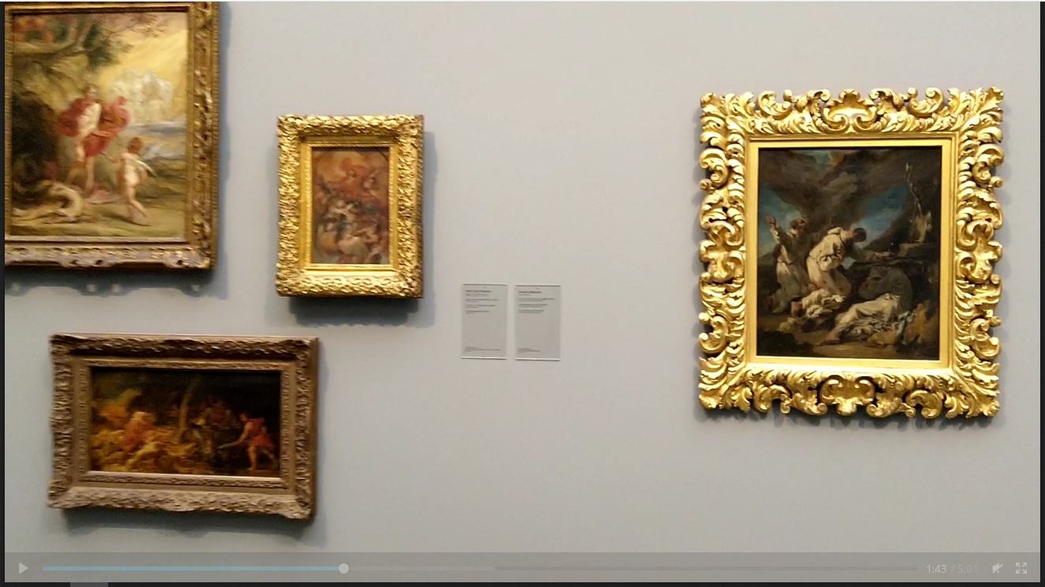
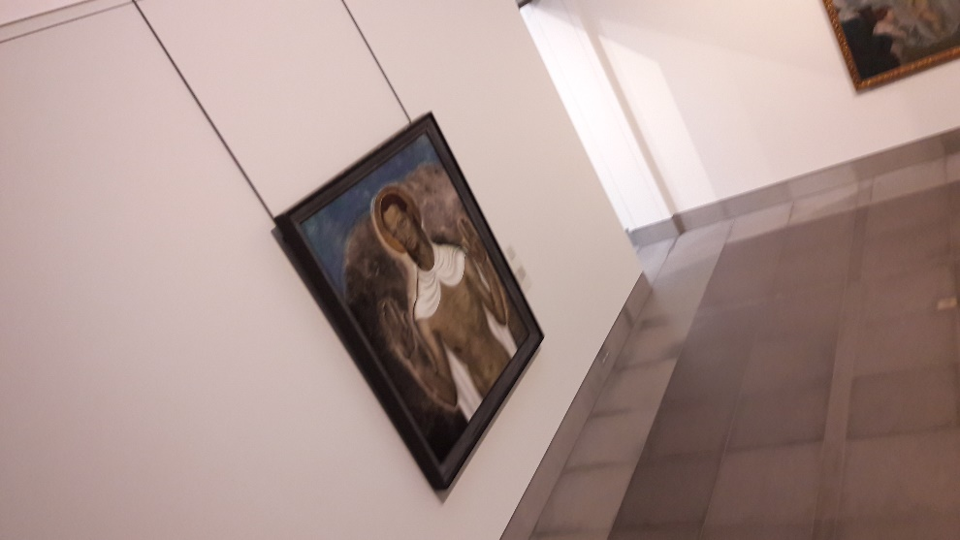
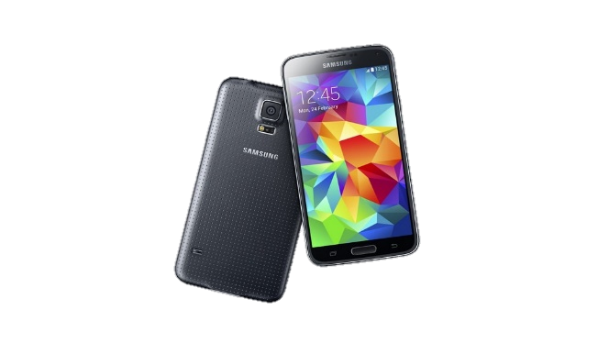
Painting Detection
Qualitative evaluation with test_pictures_msk and video frames:
Common causes of failure
Recommendations for future solutions

Slide 23
Assignment 2

Slide 24
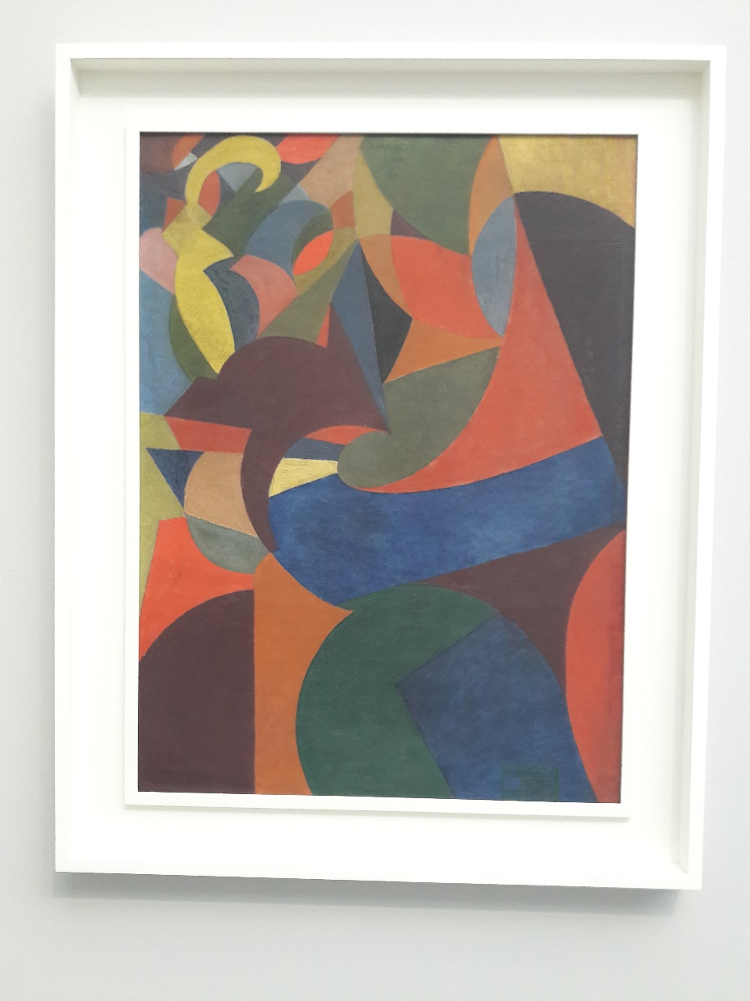
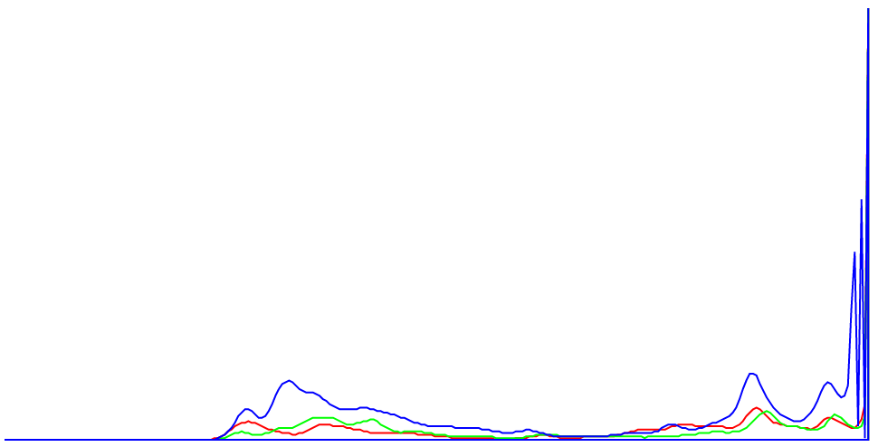
Matching
Write a painting matching program.
Compute a matching score
Use keypoints and/or feature vectors
Keypoints
Feature vectors (e.g. from color histograms)

Slide 25

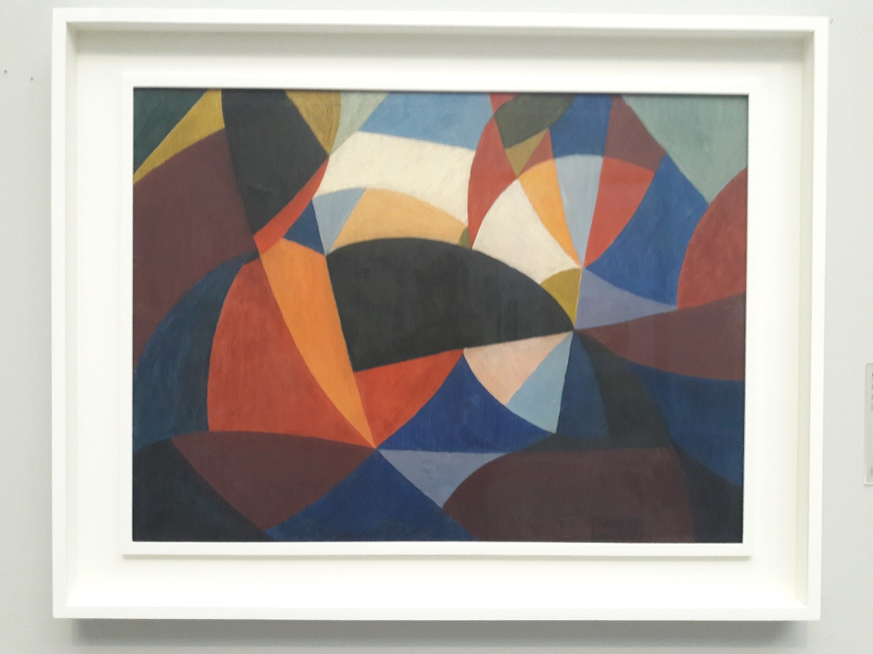
matching
Evaluate on the database:
Method’s ability to capture uniqueness
Matching score?

Slide 26
Matching
Qualitative evaluation with test_pictures_msk and video frames:
Common causes of mismatches
Recommendations for future solutions

Slide 27
Assignment 3

Slide 28

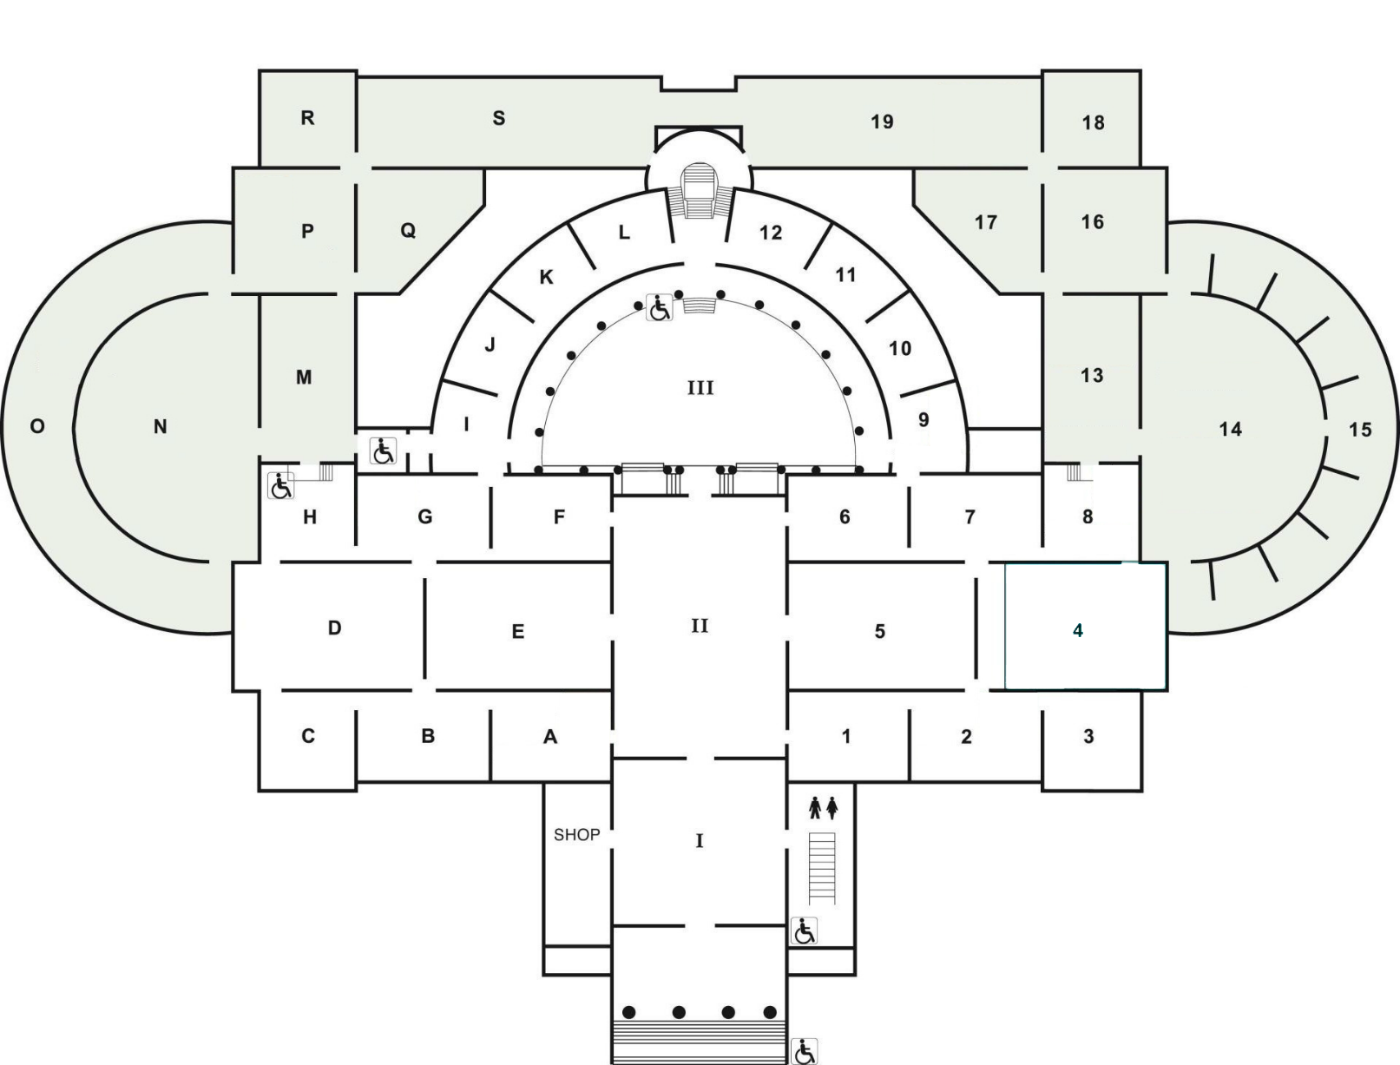

localization
Write a location estimation program.
Soft matching logic: list of best potential matches
Spatio-temporal consistency: potential locations (teleportation is not possible)

Slide 29
Assignment 4

Slide 30
demo
Create a visualization on a test video showing:
detected paintings
most likely match
estimated localization likelihoods
tracked path

Slide 31
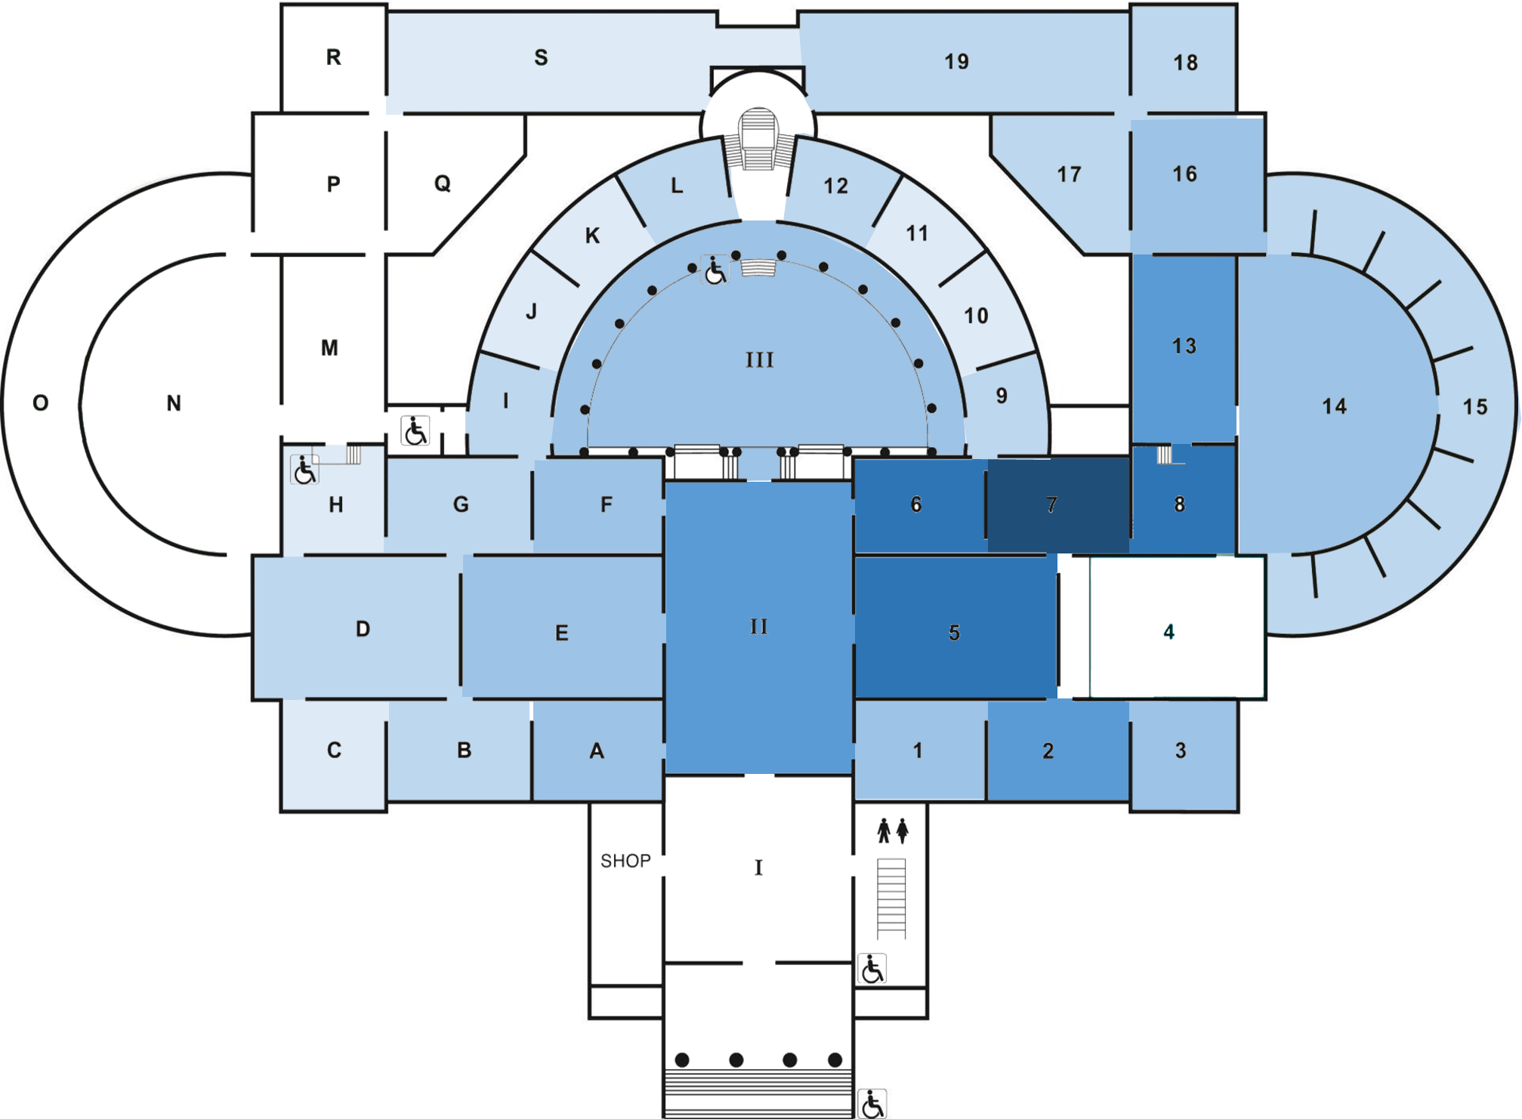

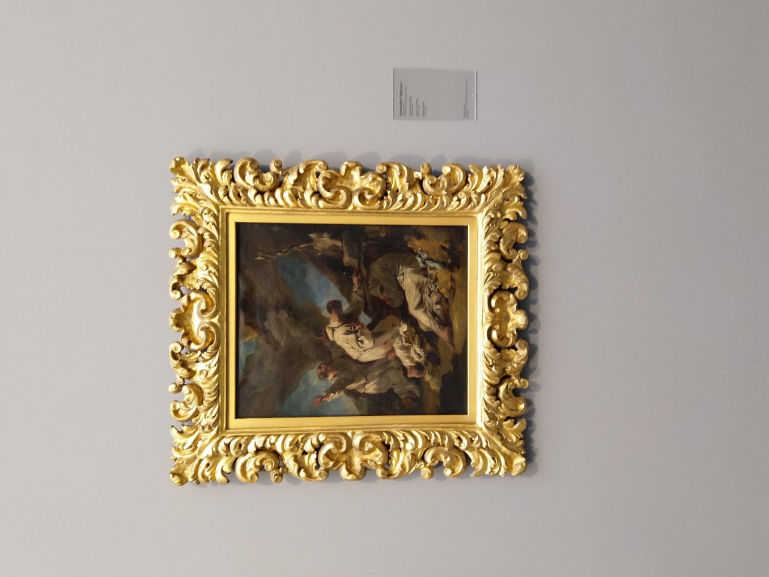
Demo
100%
0%
Match: 0.93 Image: IMG_20190323_113148.jpg Hall: 7
Current Location: Hall 7 Probability: 0.84

Slide 32
Good Luck!

Slide 33
